Slide 1
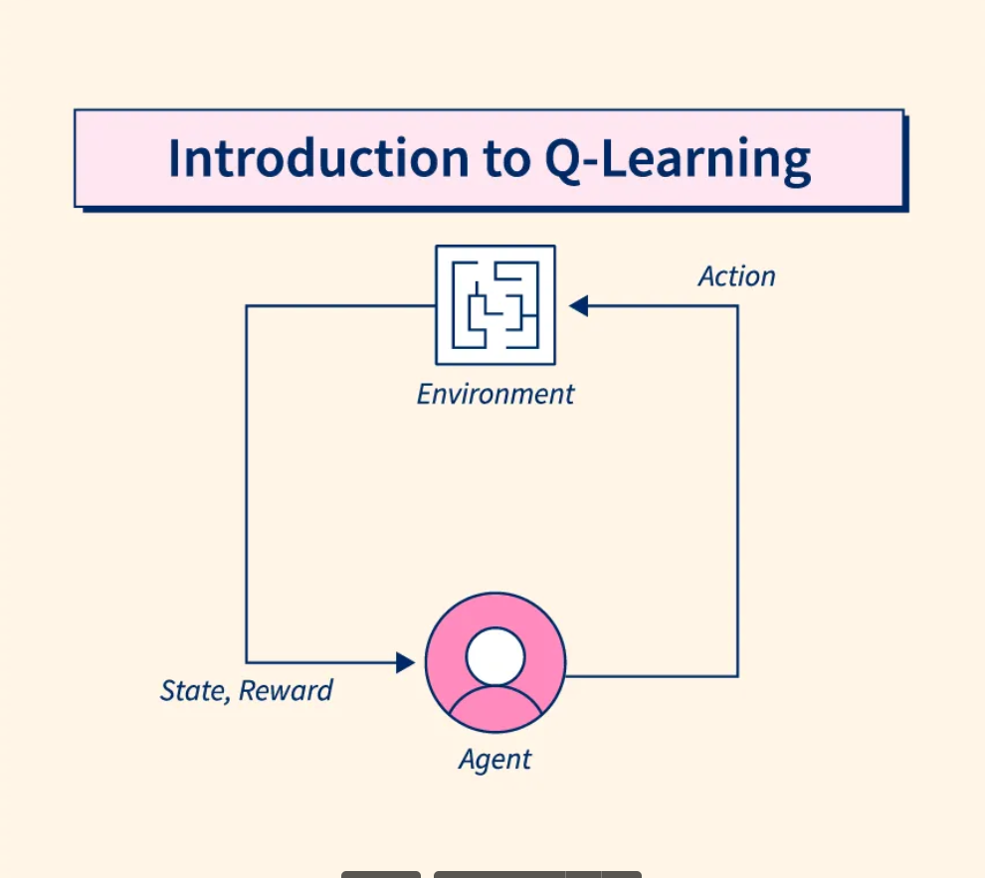
Q-LEARNING

Slide 2
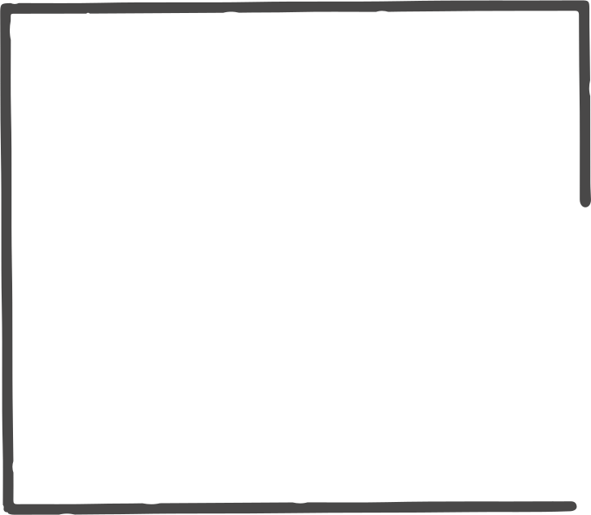
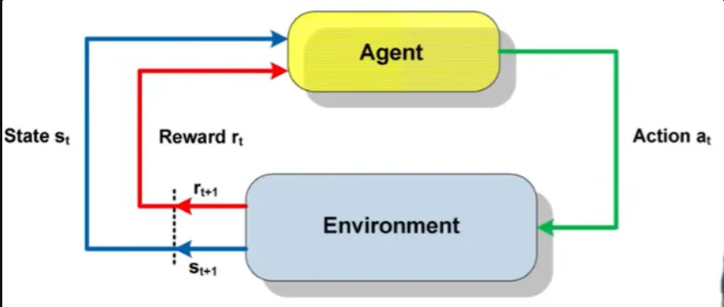
REINFORCEMENT LEARNING
agent acts on environment through some actions
receives reward based on the action taken
we do not tell the agent directly which the best action is, it learns by itself through trial and error
Components
Agent
States
Actions
Rewards
Policy

Slide 3
Q-LEARNING
value-based reinforcement learning algorithm
provides a model-free approach to reinforcement learning
used to find the optimal action-selection policy using a Q function.
Q-Value
metric used to measure an action at a particular state
estimates the expected future rewards that can be obtained by starting from that state and taking that action followed by following an optimal policy
Q-Table : lookup table to find the best action at each state
Q-Function : provides q value for table

Slide 4
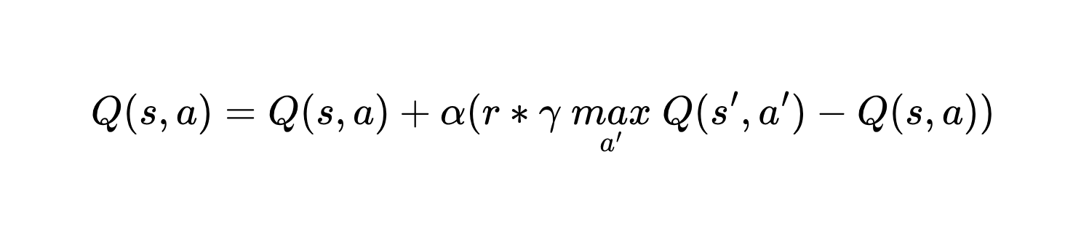
BELLMAN’S EQUATION
used as q function
recursive formula for optimal decision making
Q(s, a): expected reward for taking action a in state s
r: actual reward received for that action
s, s’: current state, next state
α: learning rate
γ: discount factor
max(Q(s', a')): highest expected reward for all possible actions a' in state s'

Slide 5
Q-LEARNING ALGORITHM
Initialize Q-Table (with all zeros)
Select initial state S
Repeat :
Choose action A
Perform action A
Calculate reward for performing A from State S
Use Q-Function to update Q-Table
S = S’
(stop when S is terminating state)

Slide 6
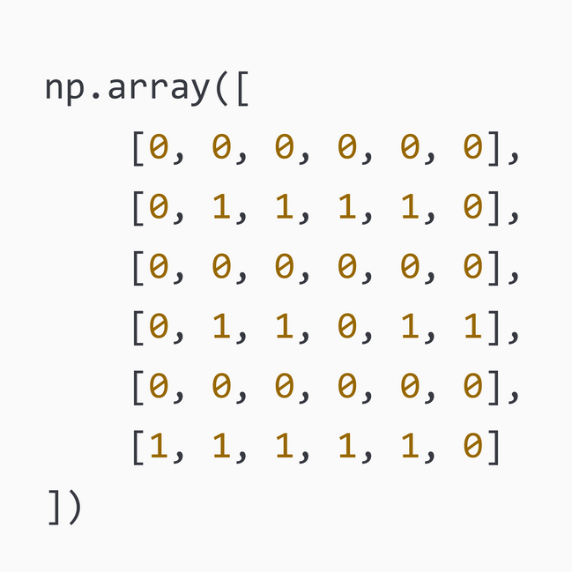
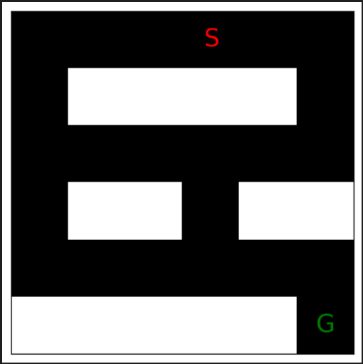
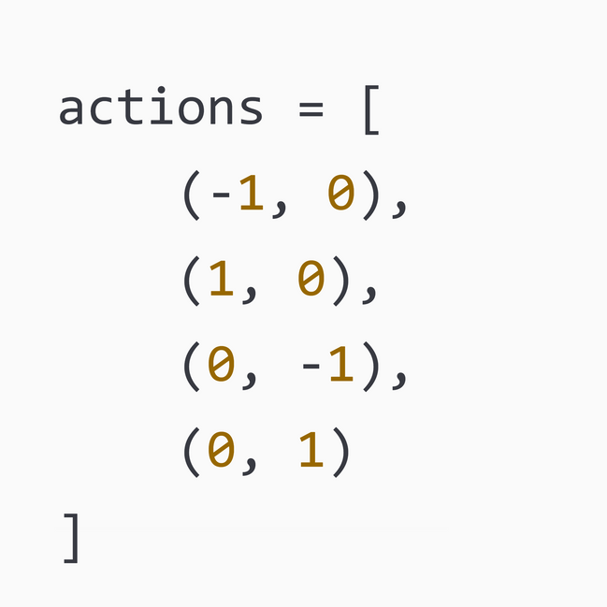
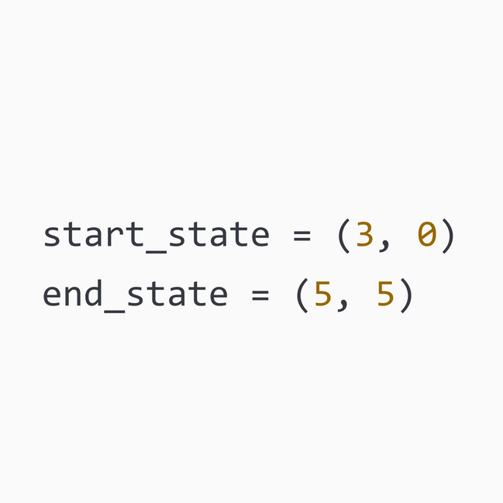
Q-LEARNING IMPLEMENTATION
01. Define the environment
create variables for states and actions

Slide 7
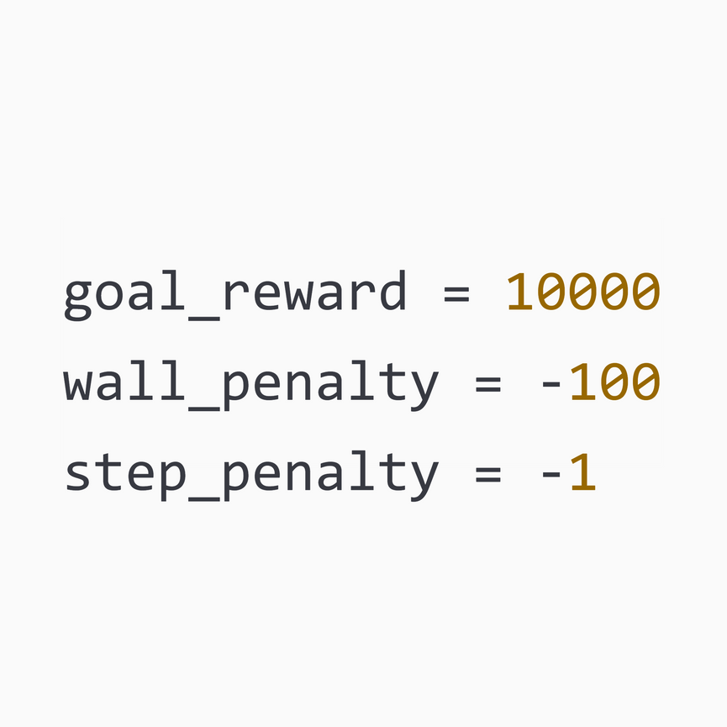
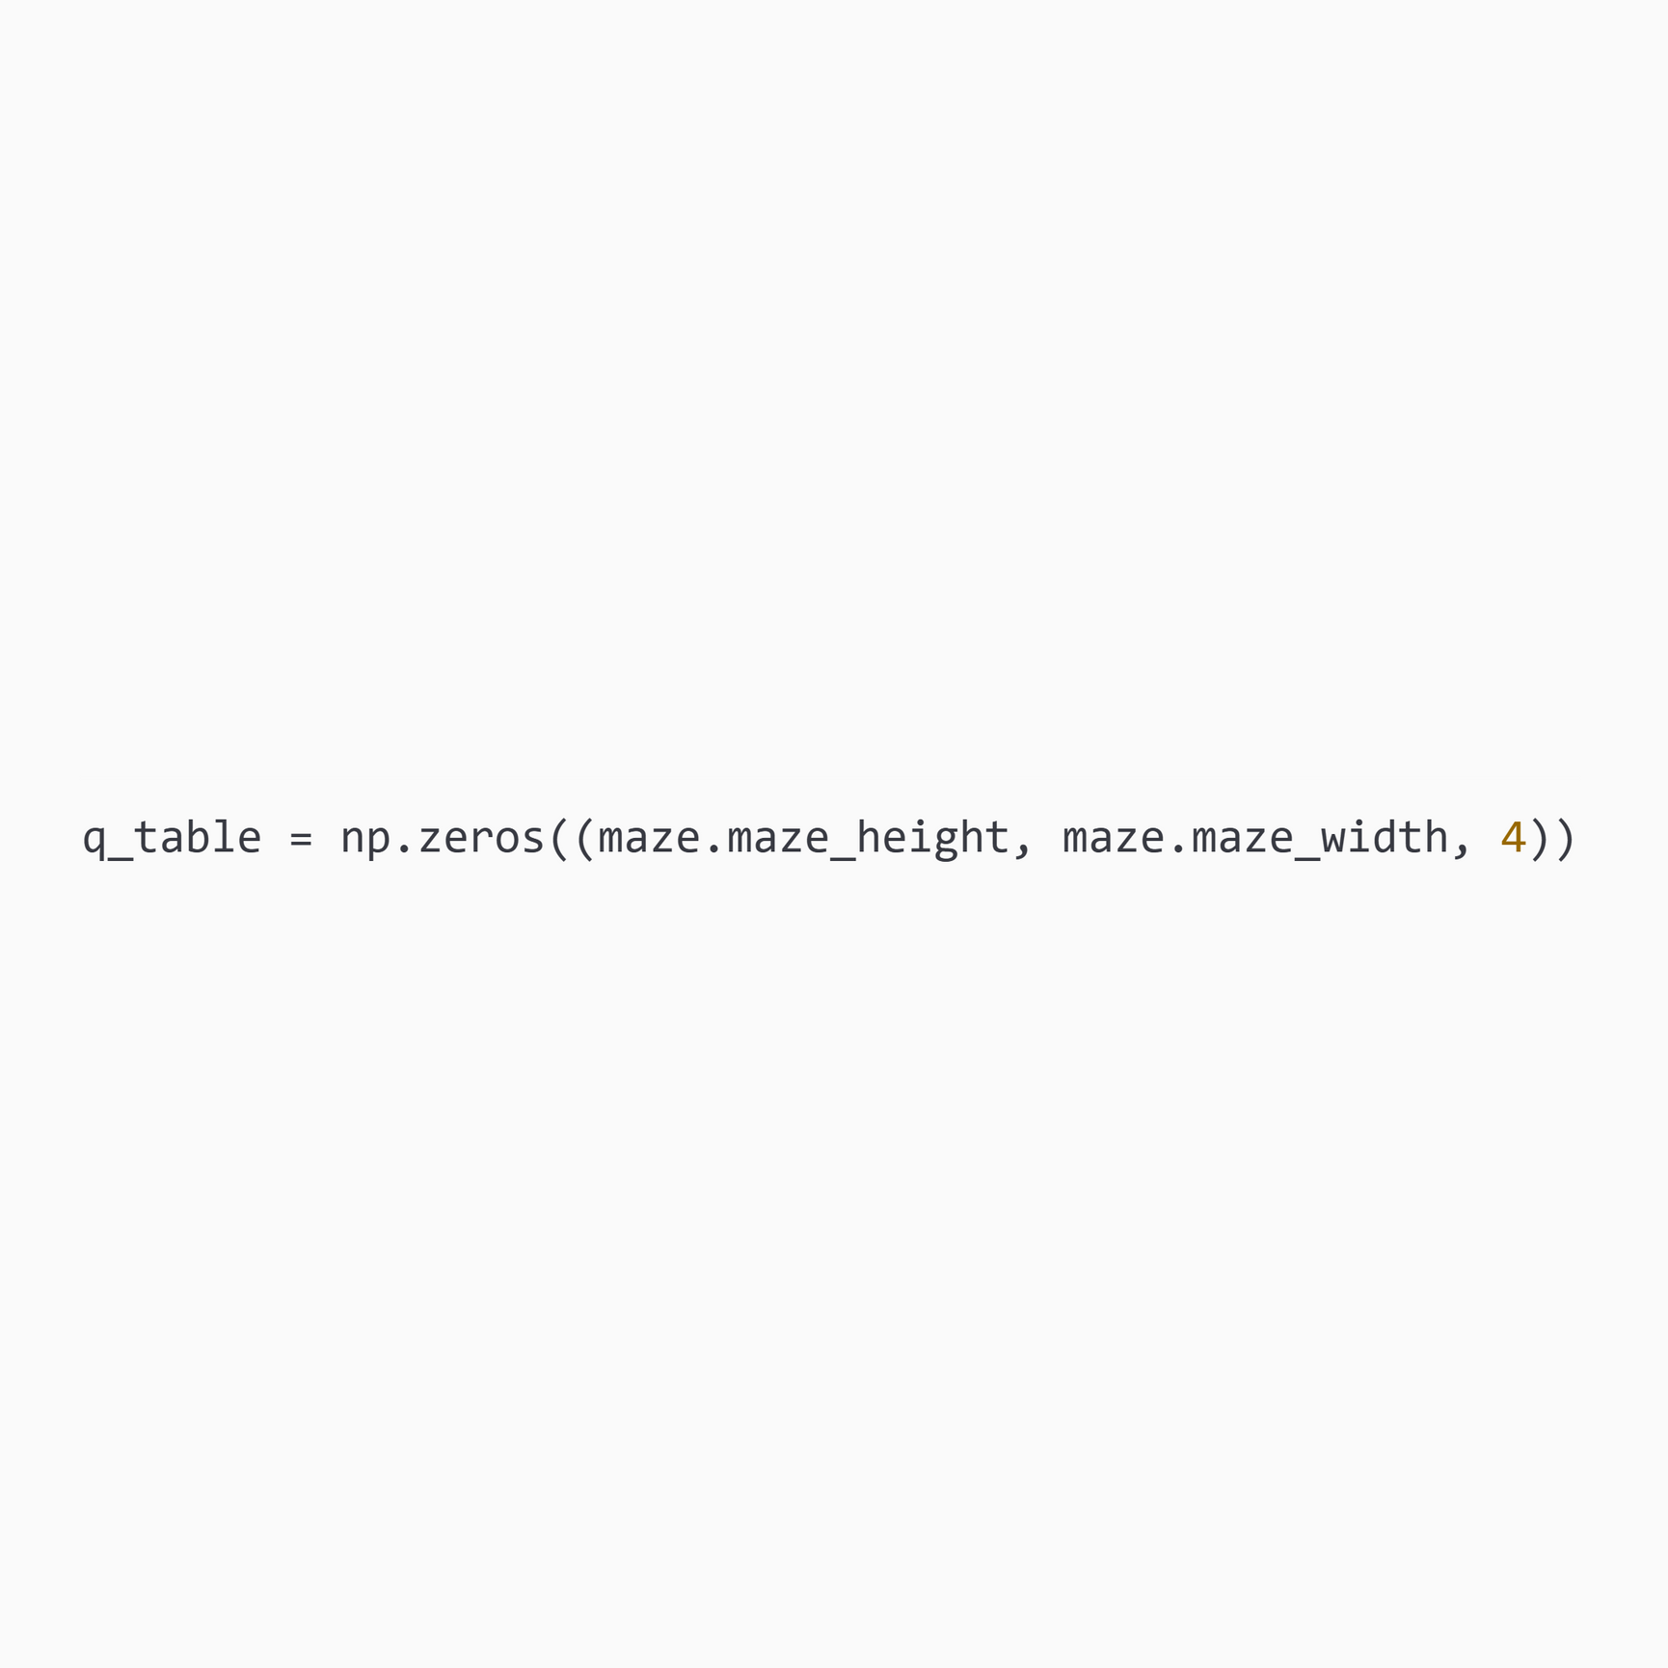
Q-LEARNING IMPLEMENTATION
02. Define the rewards
03. Initialize the q-table

Slide 8
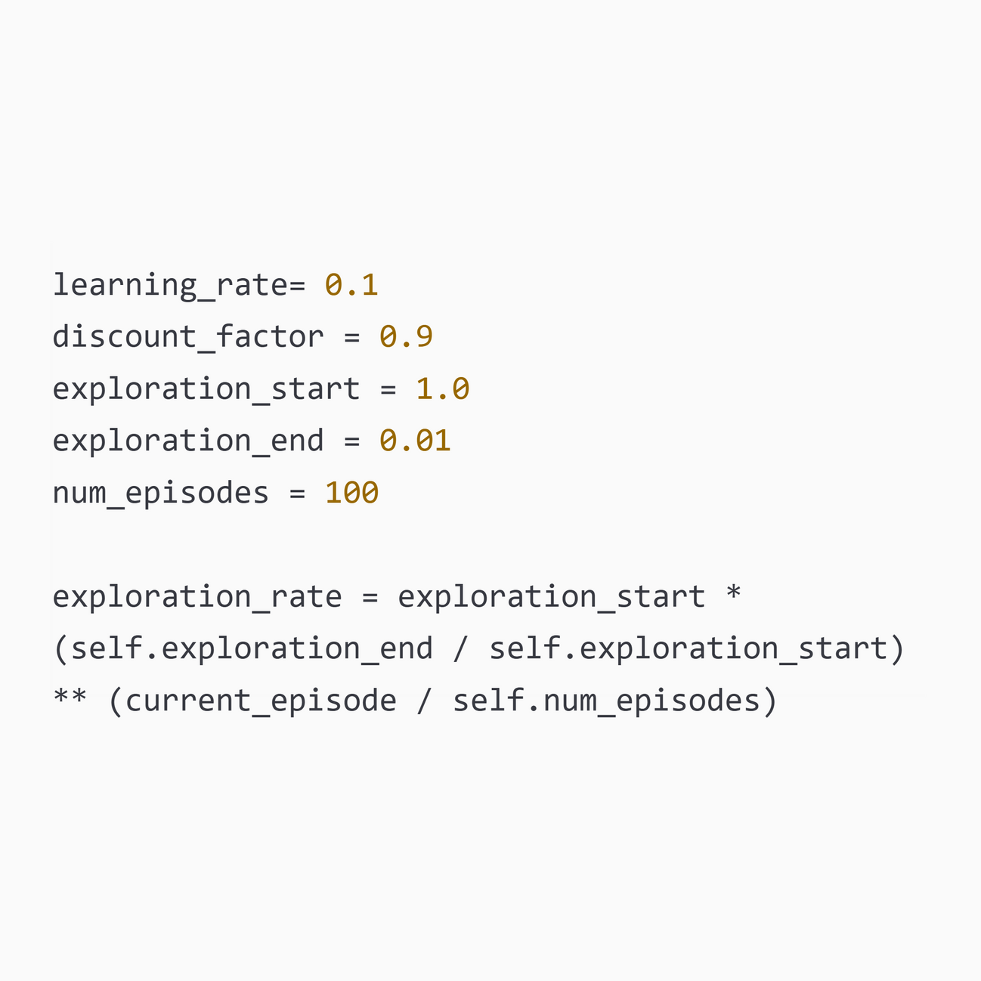
Q-LEARNING IMPLEMENTATION
04. Initialize parameters

Slide 9
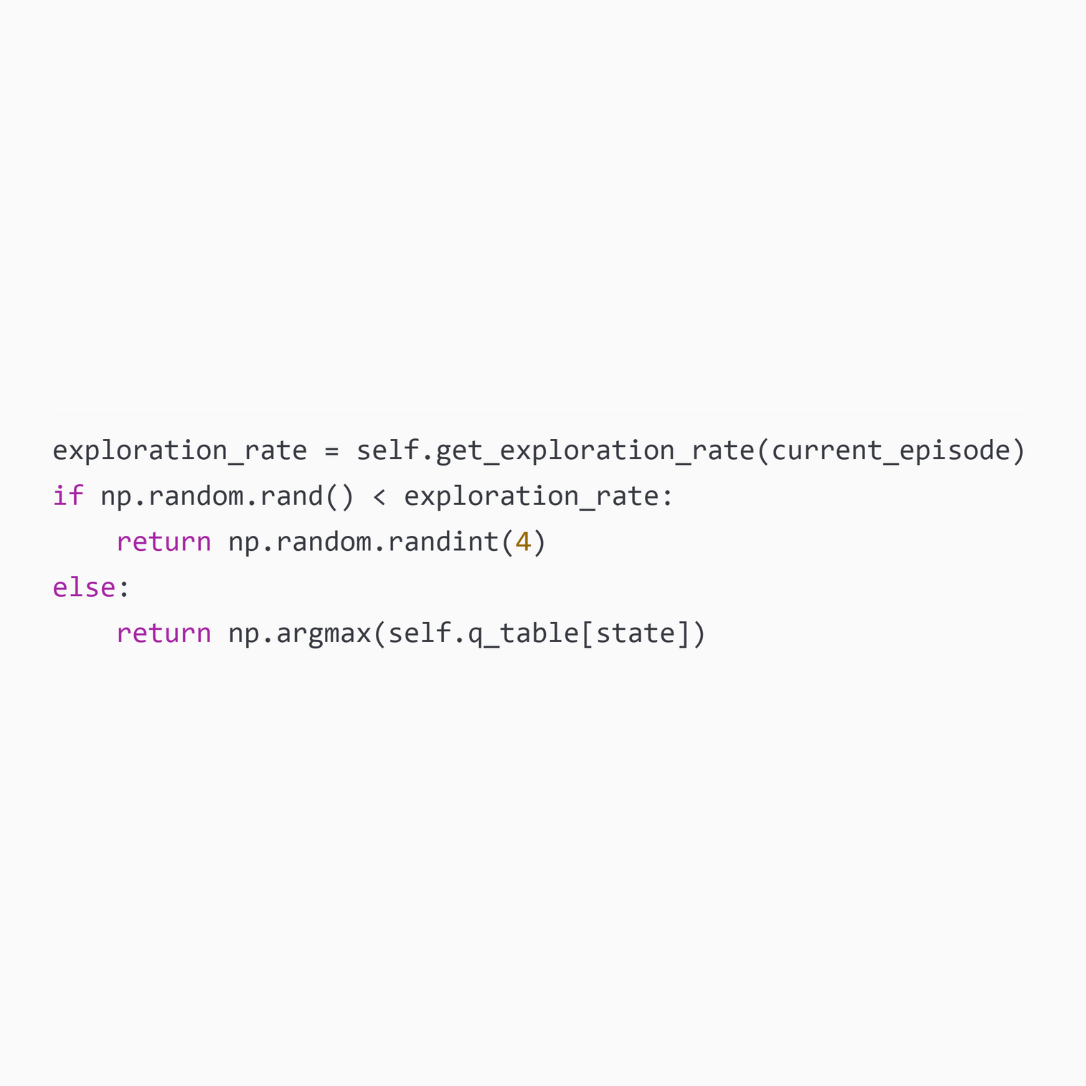
Q-LEARNING IMPLEMENTATION
05. Training loop
a. Choose action

Slide 10
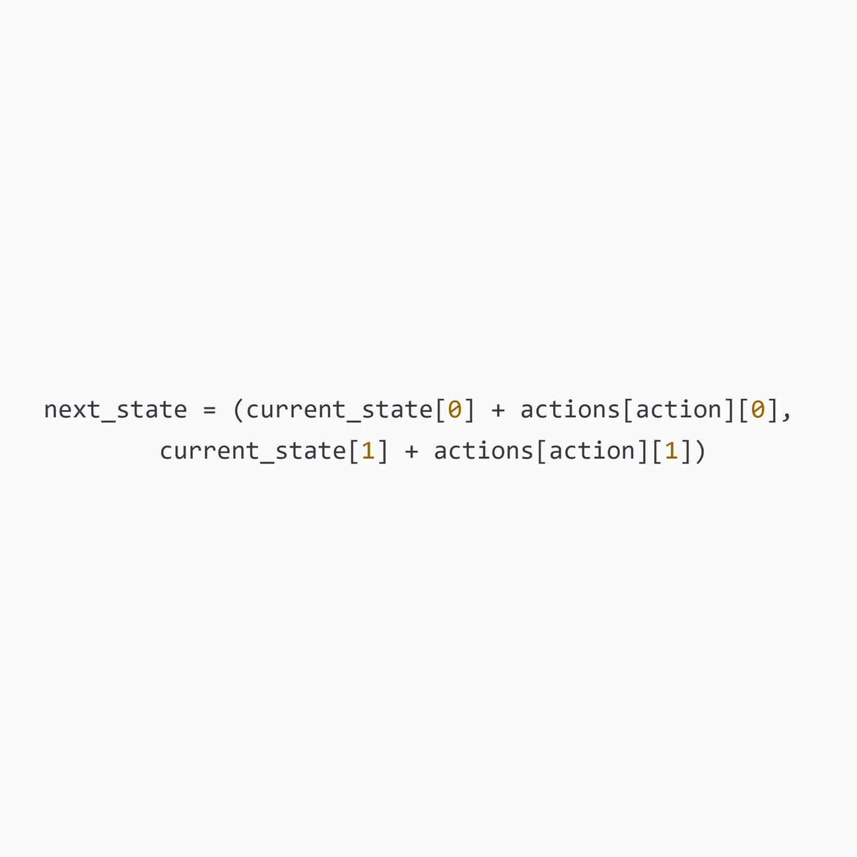
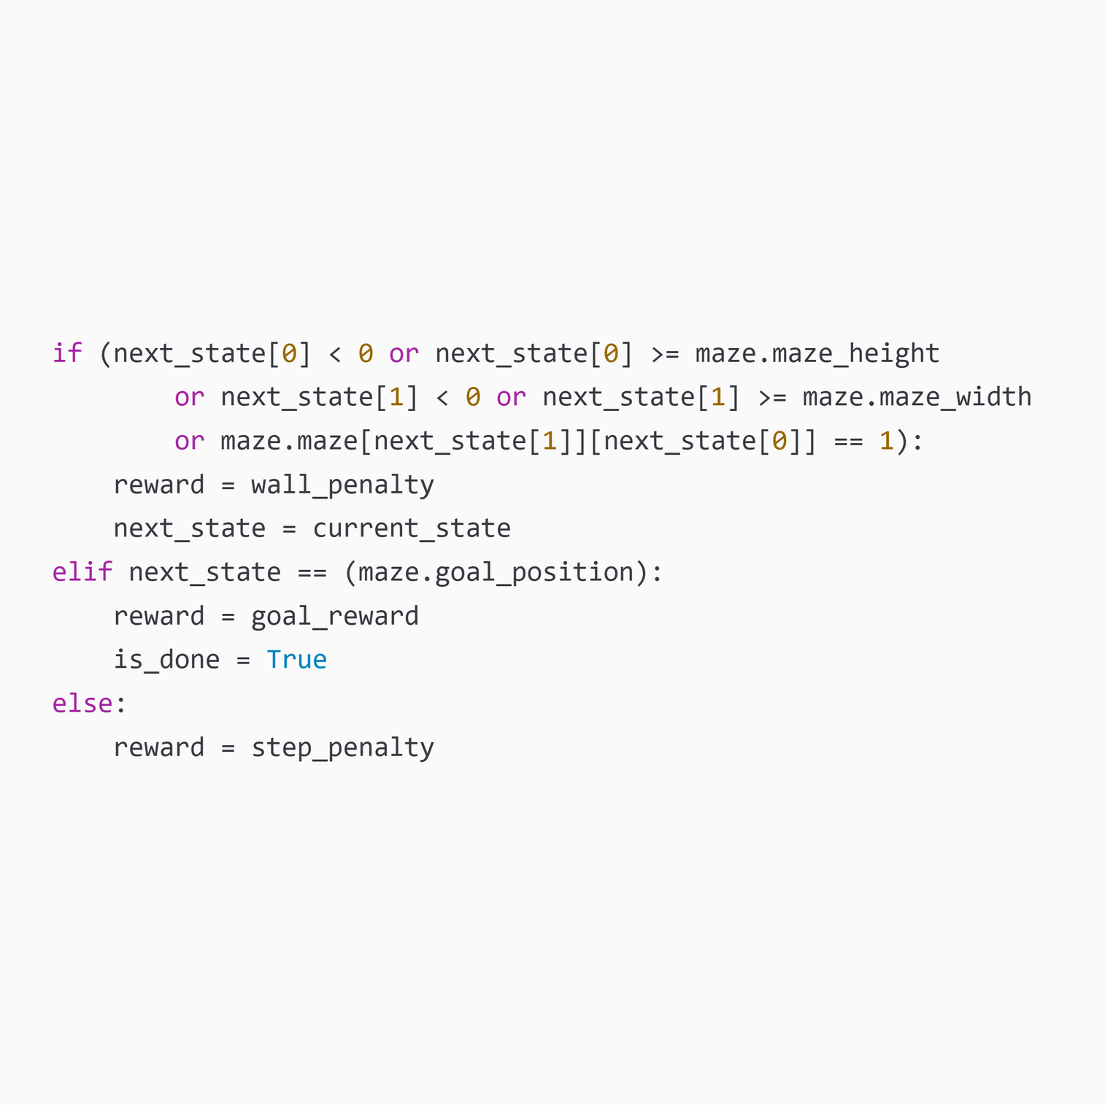
Q-LEARNING IMPLEMENTATION
05. Training loop
b. Perform action
c. Calculate reward

Slide 11
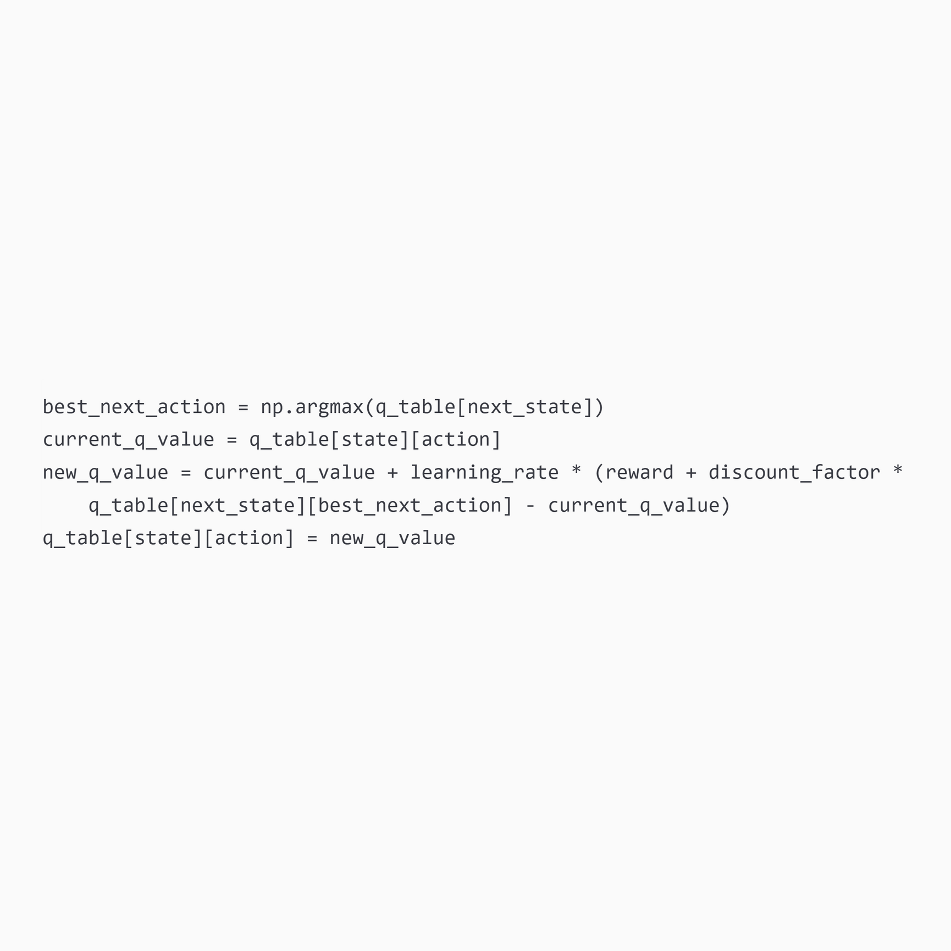
Q-LEARNING IMPLEMENTATION
05. Training loop
d. Update q-table

Slide 12
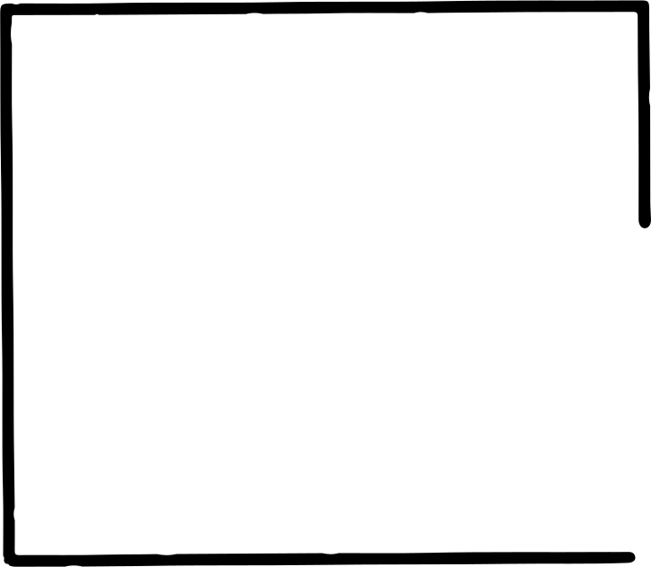
THANK YOU

